Slide 1

MAS291
COMPUTER PROJECT
Group 04
Nguyen Thuong Phong
Nguyen The Hien
Nguyen Thi Ngoc Han
Nguyen Hoang Dat
Nguyen Hai Dang
Tran Dai Viet
Hua Duc Binh

Slide 2

Year | Vietnam Income | Vietnam Population | Japan Income | Japan Population
1800 | 1170 | 4000000 | 1830 | 28000000
1801 | 1170 | 4100000 | 1830 | 28100000
1802 | 1170 | 4200000 | 1830 | 28300000
1803 | 1170 | 4310000 | 1830 | 28400000
1804 | 1170 | 4410000 | 1830 | 28600000
1805 | 1170 | 4530000 | 1830 | 28700000
1806 | 1170 | 4640000 | 1830 | 28900000
1807 | 1170 | 4750000 | 1830 | 29000000
1808 | 1170 | 4870000 | 1830 | 29200000
1
DATA PROJECT
This is a data on the income of Vietnam and Japan, as well as the population of both countries for each year from 1800 to 2100. It seems to be a historical dataset tracking changes in income and population over time for these two countries.
Link data : https://www.gapminder.org/data/
2090 | 42700 | 95300000 | 70600 | 78000000
2091 | 43100 | 94900000 | 71100 | 77500000
2092 | 43700 | 94500000 | 71300 | 77100000
2093 | 44400 | 94000000 | 71800 | 76600000
2094 | 45100 | 93600000 | 72200 | 76200000
2095 | 45800 | 93200000 | 72700 | 75700000
2096 | 46600 | 92800000 | 73100 | 75300000
2097 | 46800 | 92300000 | 73500 | 74900000
2098 | 47200 | 91900000 | 73900 | 74500000
2099 | 48300 | 91500000 | 74300 | 74100000
2100 | 48900 | 91000000 | 74700 | 73600000

Slide 3

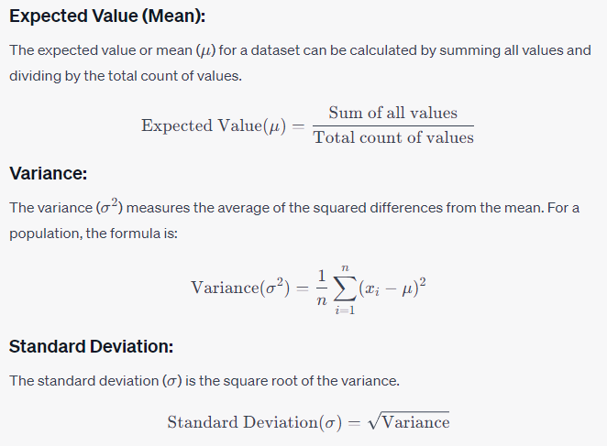
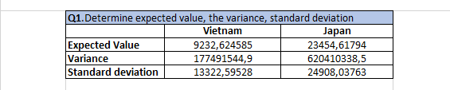
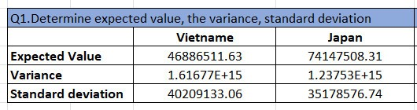
Q1.DETERMINE EXPECTED VALUE, THE VARIANCE, STANDARD DEVIATION.
Income:
Population :
Japan has a significantly higher average income than Vietnam.
Income values ​​in Japan have larger differences (higher variance and standard deviation) compared to Vietnam, indicating a larger income gap in Japan.

Slide 4
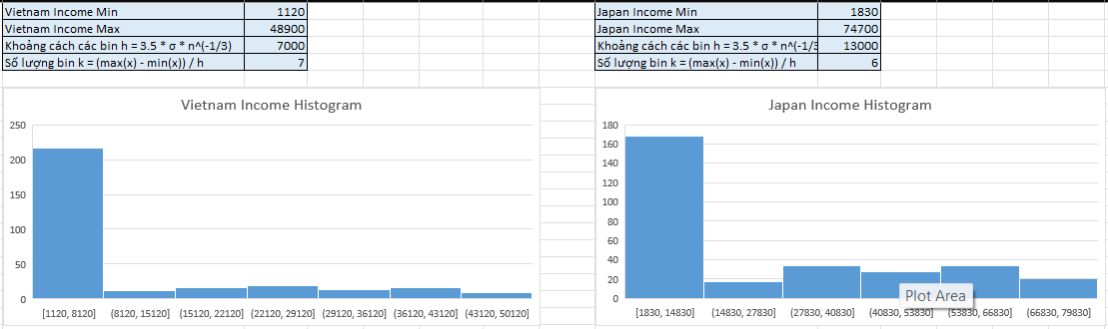
Q2.DISPLAY HISTOGRAM(S), BOXPLOT(S) AND SHOW ALL THE OUTLIERS IN THE DATA.
About Income Histogram:

Slide 5
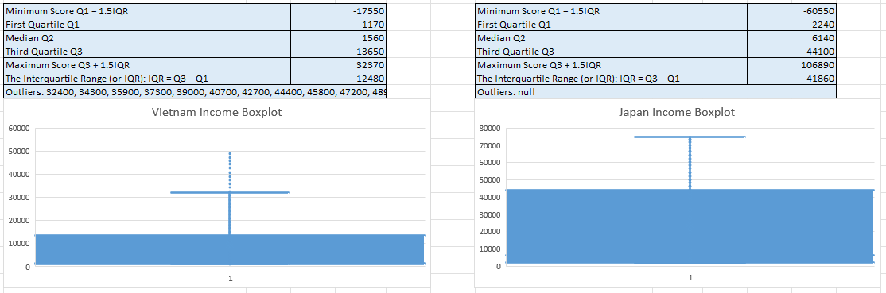
Q2.DISPLAY HISTOGRAM(S), BOXPLOT(S) AND SHOW ALL THE OUTLIERS IN THE DATA.
About Income Boxplot:

Slide 6
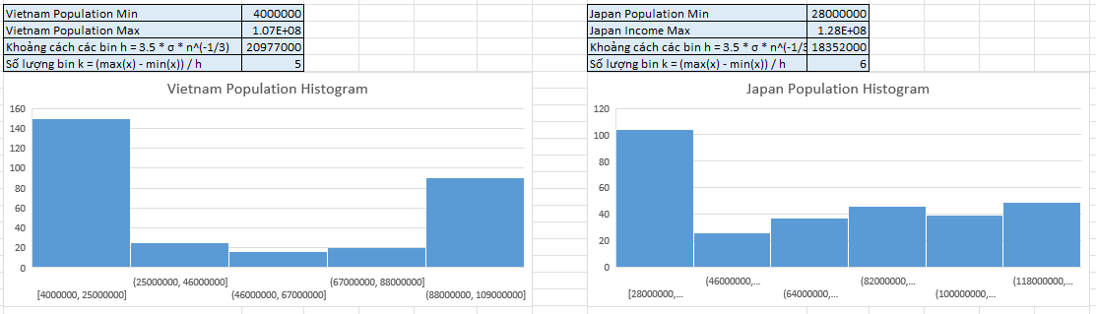
Q2.DISPLAY HISTOGRAM(S), BOXPLOT(S) AND SHOW ALL THE OUTLIERS IN THE DATA.
About Population Histogram:

Slide 7
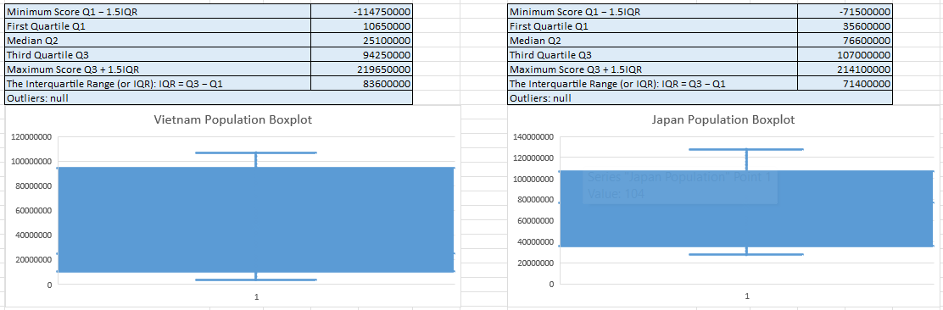
Q2.DISPLAY HISTOGRAM(S), BOXPLOT(S) AND SHOW ALL THE OUTLIERS IN THE DATA.
About Population Boxplot:

Slide 8
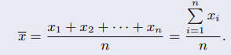
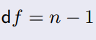
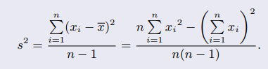
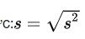
Q3. TEST A HYPOTHESIS AND CONSTRUCT A CONFIDENCE INTERVAL FOR THE MEAN OF A POPULATION.
randomly sampling 100 average incomes of Japan over the years. The research goal is to determine whether the average income of the Japanese population is different from the 30,000 USD level.
Confidence Interval: 95%
Null hypothesis: Average income of Japan is equal to 30,000: H0: µ0 == 30000
Alternative hypothesis: Japan's average income is different from 30,000: H1: µ1 != 30000.
Expected Value: 30000
Sample Size: n = 100
Sample Mean : 19220,5
Variance : 552776990,7

Slide 9
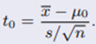
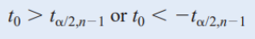
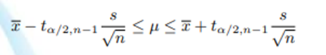
Q3. TEST A HYPOTHESIS AND CONSTRUCT A CONFIDENCE INTERVAL FOR THE MEAN OF A POPULATION.
α = 0.05
n = 100
Confident interval:
Lower-Confidence Interval | 14555,36588
Upper-Confidence Interval | 23885,63412
=-4.58
Reject region H0 if
t0 = -4.58 < -1.98
=> Reject H0
Conclusion: Japan's average income is less than 30,000 USD, consistent with hypothesis H1 with about 95% confidence from 14555.3659 to 23885.6341

Slide 10
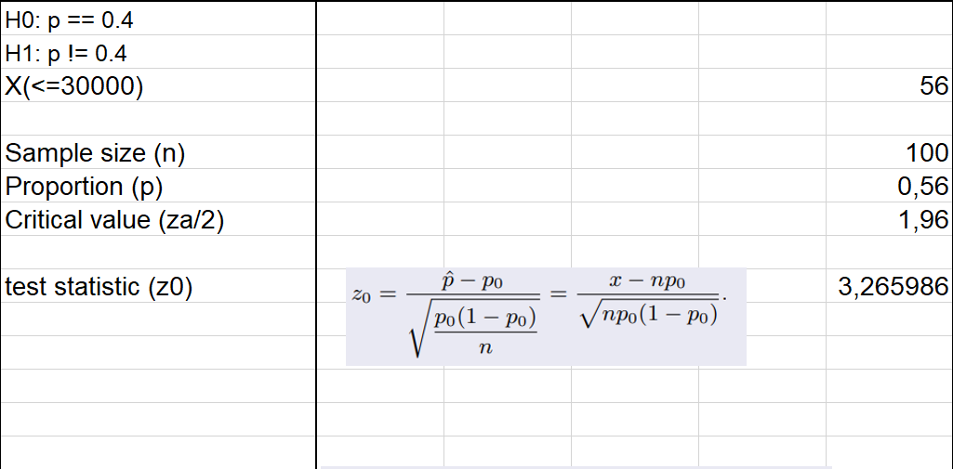
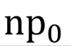
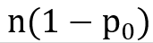
Q4. TEST A HYPOTHESIS AND CONSTRUCT A CONFIDENCE INTERVAL FOR THE PROPORTION OF A POPULATION.
Determine the incomes less than 30,000 USD of population in Japan. Data were collected from a random sample of 100 populations . The results showed that 56 populations had income less than 30.000 USD. At the 0.05 level of significance, is there any evidence that difference of 40% of population have income less 30,000 USD?
= 100*0.4=40
= 60
Conclusion: 1.96 < test statistic = 3.265986. so you can reject H0. So there is evidence that difference of 40% of population have income less 30,000 USD

Slide 11
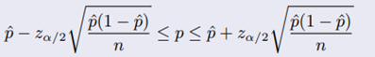
Q4. TEST A HYPOTHESIS AND CONSTRUCT A CONFIDENCE INTERVAL FOR THE PROPORTION OF A POPULATION.
A random sample of 100 income from population in Japan shows that 56 populations have incomes less than or equal 30.000. Construct a 95% confidence interval for the true proportion of incomes less than 30,000 USD.
0.46<=p<=0.66

Slide 12
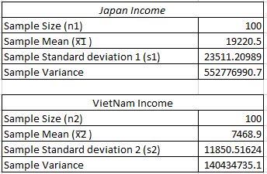
Q5. TEST A HYPOTHESIS AND CONSTRUCT A CONFIDENCE INTERVAL FOR THE DIFFERENCE IN MEANS OF TWO POPULATIONS.
We have two random data samples on income in Vietnam and Japan from 1800 to 2100. Each sample has 100 observations. Determine whether there is a difference between the means income of Vietnam and Japan in this period at a 0,05 significance level and assume unequal variances. And construct a 95% confidence interval for the difference in mean income between the two countries.

Slide 13
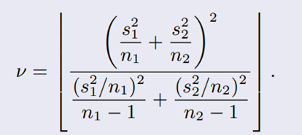
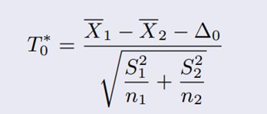
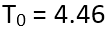
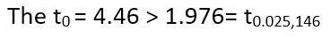
Q5. TEST A HYPOTHESIS AND CONSTRUCT A CONFIDENCE INTERVAL FOR THE DIFFERENCE IN MEANS OF TWO POPULATIONS.
The significance level = 0.05 => α = 0.05 => α/2 = 0.025
The null and alternative hypotheses are:
H0: µ1 − µ2 = 0
H1: µ1 − µ2 ≠ 0
v = 146
We have α = 0.05 and v = 146, so acceptance region is:
=> Reject H0.
=> At the 0.05 significance level, conclude that evidence exists that the mean income are different for the two countries.

Slide 14
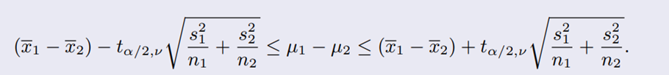
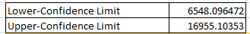
Q5. TEST A HYPOTHESIS AND CONSTRUCT A CONFIDENCE INTERVAL FOR THE DIFFERENCE IN MEANS OF TWO POPULATIONS.
Q5. TEST A HYPOTHESIS AND CONSTRUCT A CONFIDENCE INTERVAL FOR THE DIFFERENCE IN MEANS OF TWO POPULATIONS.
The 95% confidence interval is:
The mean income in Japan is higher than the mean income in VietNam with a 95% confidence.
The 95% confidence interval does not include the value 0, so we can conclude that there is a difference in the mean income between the two countries.

Slide 15

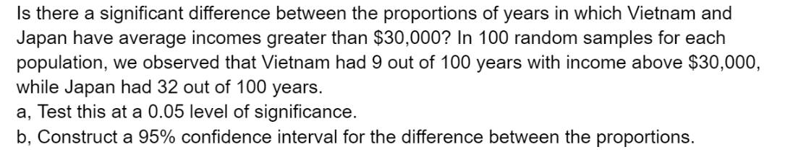
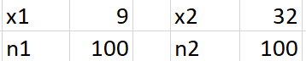
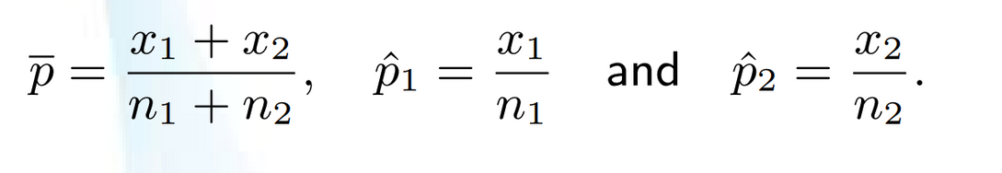
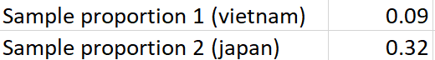

Q6. TEST A HYPOTHESIS AND CONSTRUCT A CONFIDENCE INTERVAL FOR THE DIFFERENCE IN PROPORTIONS OF TWO POPULATIONS.

Slide 16
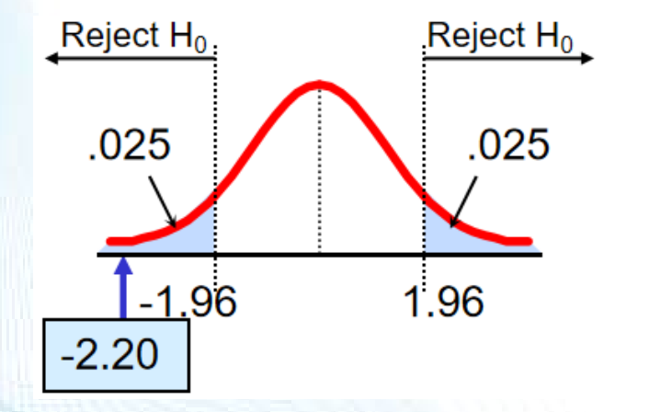
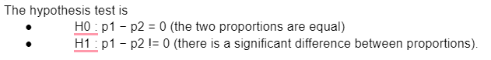
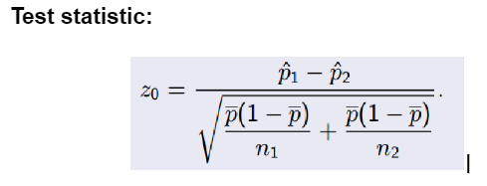
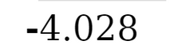
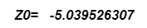
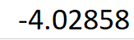
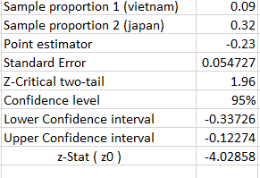
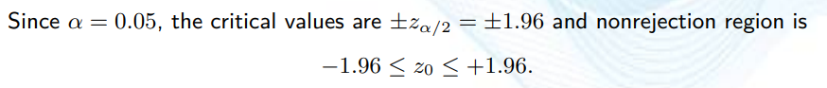
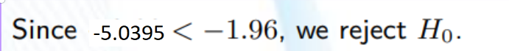
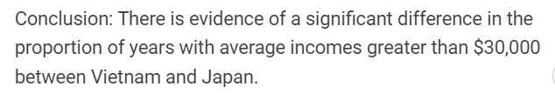

Slide 17

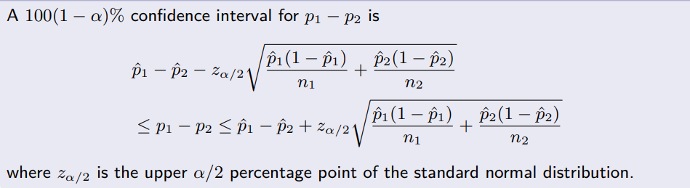
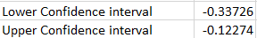
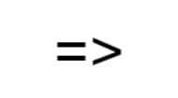
Conclusion: We are 95% confident that the difference between the proportions of years with average incomes greater than $30,000 in Vietnam and Japan is between (-0.33726, -012274) .

Slide 18

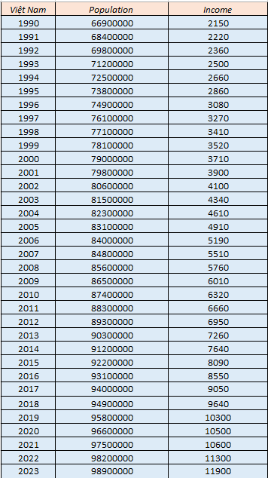
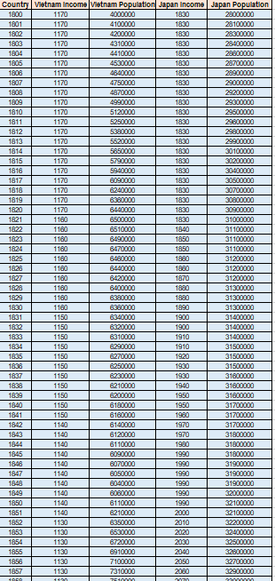
7. Regression analysis. In this requirement, you are expected to complete
the following steps:
(Đức Bình)
Subs Question:
a) Identify two random variables X and Y in data.
b) Construct a scatter plot for the data.
c) Compute the sample correlation coefficient.
d) Find the equation of the estimated regression line.
Predict a future value for Y.
e) Test the significance of regression.
(Sample Viet Nam)

Slide 19
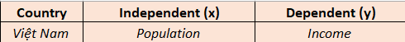
7. Regression analysis. In this requirement, you are expected to complete
the following steps:
a) Identify two random variables X and Y in data:

Slide 20
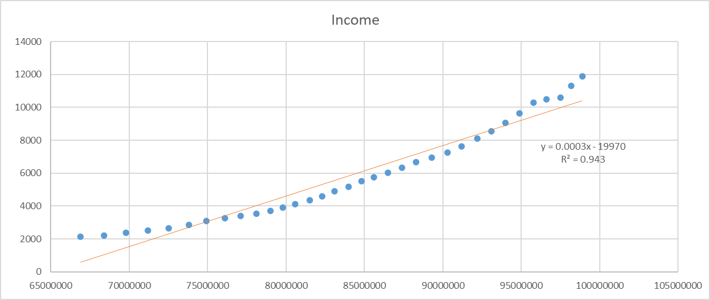
7. Regression analysis. In this requirement, you are expected to complete
the following steps:
b) Construct a scatter plot for the data:

Slide 21
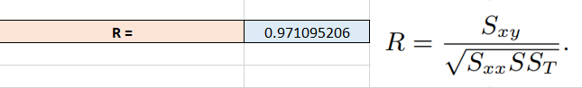
7. Regression analysis. In this requirement, you are expected to complete
the following steps:
c) Compute the sample correlation coefficient:

Slide 22
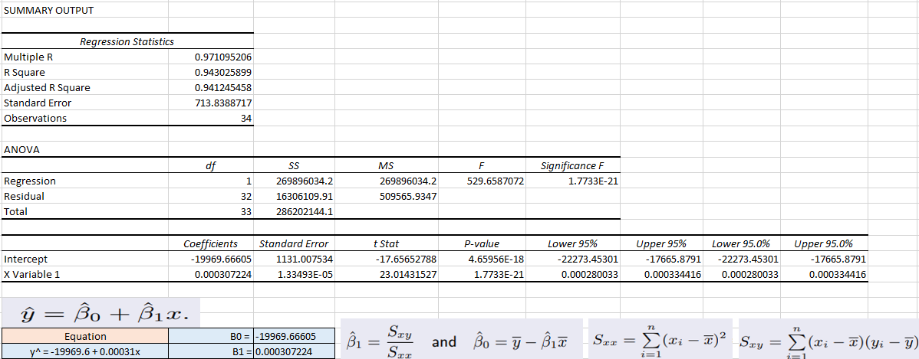
7. Regression analysis. In this requirement, you are expected to complete
the following steps:
d) Find the equation of the estimated regression line:

Slide 23
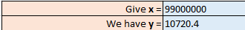
7. Regression analysis. In this requirement, you are expected to complete
the following steps:
Predict a future value for Y:

Slide 24
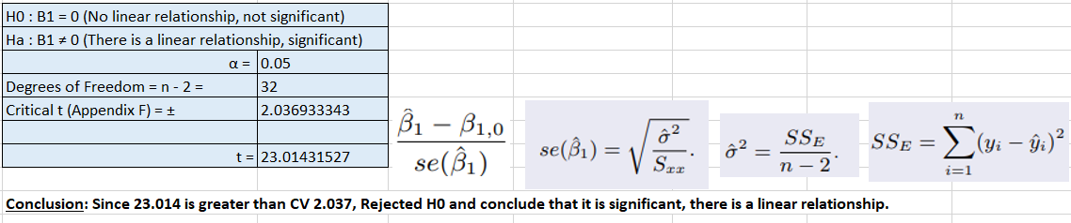



7. Regression analysis. In this requirement, you are expected to complete
the following steps:
e) Test the significance of regression:
Other Methos To Slove:
(Population Correlation Coefficient)

Slide 25
Group04
Thank For Watching The Presentation!

